Slide 1
Data Processing in Python Part 2
Benjamin Rudski
July 21, 2025

Slide 2



QLS-MiCM mission statement: deliver quality workshops designed to help biomedical researchers develop the skills they need to succeed.
Location: 550 Sherbrooke Street, Montreal, Quebec
Scan the QR code to sign up
for our mailing list
Contact: workshop-micm@mcgill.ca

Slide 3
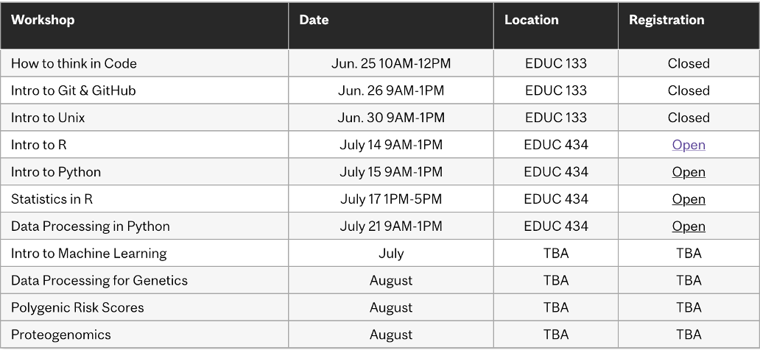
Workshop Series
https://www.mcgill.ca/micm/training/workshops-series

Slide 4
Learning Outcomes
Summary
In this 4-hour workshop, students will learn basic data processing skills using Python. Attendees will learn how to import code from other modules and packages to take advantage of the existing Python ecosystem. After seeing how to access packages, we will explore popular data analysis packages. We will see how to use NumPy to perform operations on large data arrays and how to use Matplotlib to generate clear data visualisations. We will also scratch the surface on using pandas to store data in tables. Along the way, we will discuss how to approach a new, unfamiliar package and learn how to use it.
Learning Objectives
Import code from existing modules and packages.
Use NumPy to easily process multidimensional data.
Use Matplotlib to generate different types of plots to visualise data.
Use pandas to represent data stored in tables.
Approach a new package and explore its documentation and examples.

Slide 5
Outline
Module 1 – Modules and Packages (40 minutes)
Using Modules
A Brief Intro to Package Management
Exercise
Module 2 – Introduction to NumPy Arrays (50 minutes)
Introduction to Arrays
Introducing NumPy
Array Operations
Exercise

Slide 6
Outline
Module 3 – Visualising Data with Matplotlib (50 minutes)
Creating Plots with Matplotlib
Exploring the Matplotlib Documentation
Exercise
Module 4 – Intro to Tabular Data with Pandas (30 minutes)
Fundamentals of pandas
Exploring the pandas Documentation
Module 5 – A Brief Guide to Exploring the Unknown (10 minutes)
What to learn next? How?
How to get help and how not to get help
Other cool programming topics

Slide 7

Interactive Workshop!
That’s pretty much all that will be in the slides… For the rest, we’ll go to a Jupyter Notebook:
To the repository!

Slide 8
Module 2 Introduction to NumPy Arrays

Slide 9
my_array
(0, 0) | (0, 1) | (0, 2) | (0, 3) | (0, 4) | (0, 5)
(1, 0) | (1, 1) | (1, 2) | (1, 3) | (1, 4) | (1, 5)
(2, 0) | (2, 1) | (2, 2) | (2, 3) | (2, 4) | (2, 5)
(3, 0) | (3, 1) | (3, 2) | (3, 3) | (3, 4) | (3, 5)
(4, 0) | (4, 1) | (4, 2) | (4, 3) | (4, 4) | (4, 5)
Shape: (5, 6)

Slide 10
my_array[0]?
(0, 0) | (0, 1) | (0, 2) | (0, 3) | (0, 4) | (0, 5)
(1, 0) | (1, 1) | (1, 2) | (1, 3) | (1, 4) | (1, 5)
(2, 0) | (2, 1) | (2, 2) | (2, 3) | (2, 4) | (2, 5)
(3, 0) | (3, 1) | (3, 2) | (3, 3) | (3, 4) | (3, 5)
(4, 0) | (4, 1) | (4, 2) | (4, 3) | (4, 4) | (4, 5)
Shape: (5, 6)

Slide 11
my_array[0]
(0, 0) | (0, 1) | (0, 2) | (0, 3) | (0, 4) | (0, 5)
(1, 0) | (1, 1) | (1, 2) | (1, 3) | (1, 4) | (1, 5)
(2, 0) | (2, 1) | (2, 2) | (2, 3) | (2, 4) | (2, 5)
(3, 0) | (3, 1) | (3, 2) | (3, 3) | (3, 4) | (3, 5)
(4, 0) | (4, 1) | (4, 2) | (4, 3) | (4, 4) | (4, 5)
Shape: (5, 6)

Slide 12
my_array[:, 0]?
(0, 0) | (0, 1) | (0, 2) | (0, 3) | (0, 4) | (0, 5)
(1, 0) | (1, 1) | (1, 2) | (1, 3) | (1, 4) | (1, 5)
(2, 0) | (2, 1) | (2, 2) | (2, 3) | (2, 4) | (2, 5)
(3, 0) | (3, 1) | (3, 2) | (3, 3) | (3, 4) | (3, 5)
(4, 0) | (4, 1) | (4, 2) | (4, 3) | (4, 4) | (4, 5)
Shape: (5, 6)

Slide 13
my_array[:, 0]
(0, 0) | (0, 1) | (0, 2) | (0, 3) | (0, 4) | (0, 5)
(1, 0) | (1, 1) | (1, 2) | (1, 3) | (1, 4) | (1, 5)
(2, 0) | (2, 1) | (2, 2) | (2, 3) | (2, 4) | (2, 5)
(3, 0) | (3, 1) | (3, 2) | (3, 3) | (3, 4) | (3, 5)
(4, 0) | (4, 1) | (4, 2) | (4, 3) | (4, 4) | (4, 5)
Shape: (5, 6)

Slide 14
my_array[1:3, 2:4]?
(0, 0) | (0, 1) | (0, 2) | (0, 3) | (0, 4) | (0, 5)
(1, 0) | (1, 1) | (1, 2) | (1, 3) | (1, 4) | (1, 5)
(2, 0) | (2, 1) | (2, 2) | (2, 3) | (2, 4) | (2, 5)
(3, 0) | (3, 1) | (3, 2) | (3, 3) | (3, 4) | (3, 5)
(4, 0) | (4, 1) | (4, 2) | (4, 3) | (4, 4) | (4, 5)
Shape: (5, 6)

Slide 15
my_array[1:3, 2:4]
(0, 0) | (0, 1) | (0, 2) | (0, 3) | (0, 4) | (0, 5)
(1, 0) | (1, 1) | (1, 2) | (1, 3) | (1, 4) | (1, 5)
(2, 0) | (2, 1) | (2, 2) | (2, 3) | (2, 4) | (2, 5)
(3, 0) | (3, 1) | (3, 2) | (3, 3) | (3, 4) | (3, 5)
(4, 0) | (4, 1) | (4, 2) | (4, 3) | (4, 4) | (4, 5)
Shape: (5, 6)

Slide 16
my_array[0:5:2]?
(0, 0) | (0, 1) | (0, 2) | (0, 3) | (0, 4) | (0, 5)
(1, 0) | (1, 1) | (1, 2) | (1, 3) | (1, 4) | (1, 5)
(2, 0) | (2, 1) | (2, 2) | (2, 3) | (2, 4) | (2, 5)
(3, 0) | (3, 1) | (3, 2) | (3, 3) | (3, 4) | (3, 5)
(4, 0) | (4, 1) | (4, 2) | (4, 3) | (4, 4) | (4, 5)
Shape: (5, 6)

Slide 17
my_array[0:5:2]
(0, 0) | (0, 1) | (0, 2) | (0, 3) | (0, 4) | (0, 5)
(1, 0) | (1, 1) | (1, 2) | (1, 3) | (1, 4) | (1, 5)
(2, 0) | (2, 1) | (2, 2) | (2, 3) | (2, 4) | (2, 5)
(3, 0) | (3, 1) | (3, 2) | (3, 3) | (3, 4) | (3, 5)
(4, 0) | (4, 1) | (4, 2) | (4, 3) | (4, 4) | (4, 5)
Shape: (5, 6)

Slide 18
my_array
axis=1
(0, 0) | (0, 1) | (0, 2) | (0, 3) | (0, 4) | (0, 5)
(1, 0) | (1, 1) | (1, 2) | (1, 3) | (1, 4) | (1, 5)
(2, 0) | (2, 1) | (2, 2) | (2, 3) | (2, 4) | (2, 5)
(3, 0) | (3, 1) | (3, 2) | (3, 3) | (3, 4) | (3, 5)
(4, 0) | (4, 1) | (4, 2) | (4, 3) | (4, 4) | (4, 5)
axis=0
Shape: (5, 6)

Slide 19
Module 4 Intro to Tabular Data with pandas

Slide 20
By name: my_df.loc
 | Series 0 | Series 1 | Series 2
Row 0 | [“row 0”, “series 0”] | [“row 0”, “series 1”] | [“row 0”, “series 2”]
Row 1 | [“row 1”, “series 0”] | [“row 1”, “series 1”] | [“row 1”, “series 2”]
Row 2 | [“row 2”, “series 0”] | [“row 2”, “series 1”] | [“row 2”, “series 2”]

Slide 21
By integer number: my_df.iloc
 | Series 0 | Series 1 | Series 2
Row 0 | [0, 0] | [0, 1] | [0, 2]
Row 1 | [1, 0] | [1, 1] | [1, 2]
Row 2 | [2, 0] | [2, 1] | [2, 2]

Slide 22
To summarize
Modules and packages allow for code written by others to be easily imported and reused.
NumPy arrays allow easily storing many numbers and performing operations without having to loop.
Matplotlib can be used to generate many different types of plots.
pandas DataFrames represent data in tables.
Big projects have documentation to explain their functionality.
Now you are ready to:
Import code from existing modules and packages.
Use NumPy to easily process multidimensional data.
Use Matplotlib to generate different types of plots to visualise data.
Approach a new package and explore its documentation and examples.

Slide 23
Acknowledgements
Thank you to QLS-MiCM for giving me this opportunity and for helping me along the way.
Thank you to the professors from the McGill School of Computer Science for helping me along my programming journey and for inspiring me to share my programming experience with others.
Thank you to Professor Mathieu Blanchette, whose COMP 204 course helped introduce me to Python (back in Fall 2018).
Thank you to the Python, NumPy, Matplotlib and pandas communities!

